Slide 1
Independent Components Analysis (ICA)
Dr. Mrunal Rane

Slide 2

Cocktail Party Problem

Slide 3
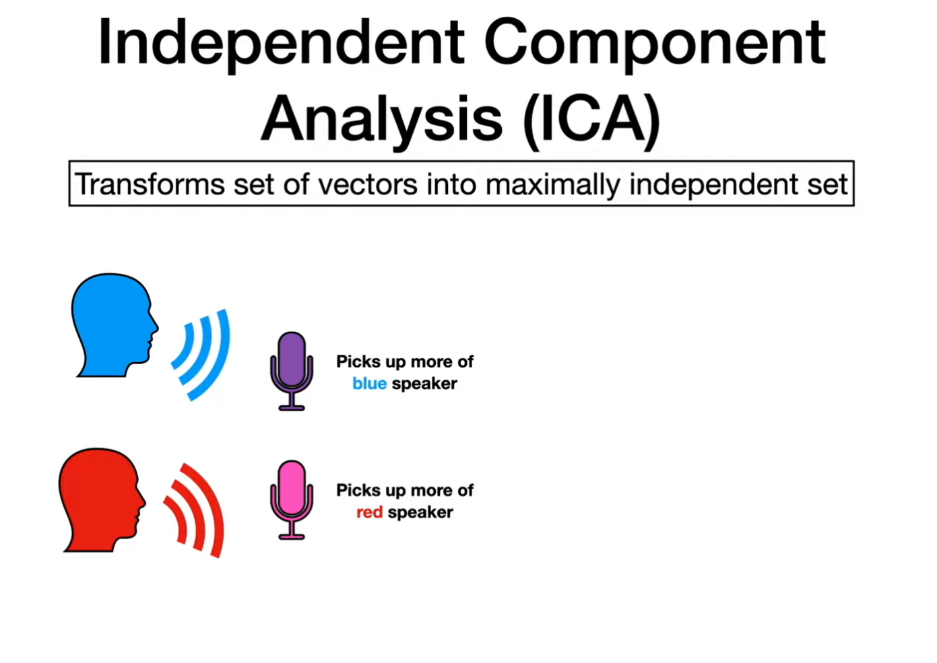
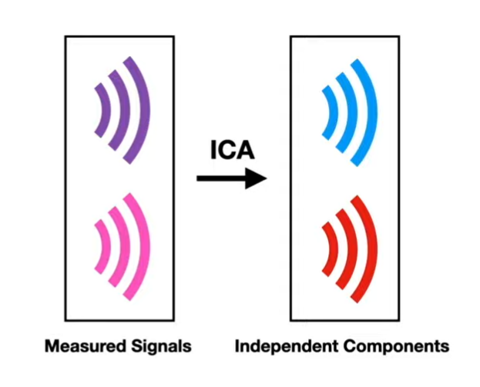

Slide 4
ICA
Independent Component Analysis (ICA) is a computational technique used to separate a multivariate signal into additive, independent components.
It is a statistical method that aims to find a linear transformation of the observed data

Slide 5
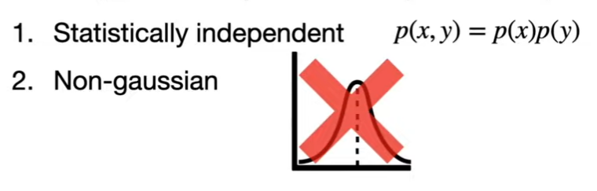
Assumptions
Statistical Independence: ICA assumes that the underlying sources are statistically independent from each other. This is a stronger assumption than assuming uncorrelatedness.
Non-Gaussianity: ICA exploits the non-Gaussian nature of the sources. In many real-world scenarios, natural signals tend to have non-Gaussian distributions, making them distinguishable from each other.
Linear Mixture Model: ICA assumes that the observed data is a linear combination of the independent sources, corrupted by noise. Mathematically, this can be represented as:
x=As+n
where:
x is the observed data (mixtures).
s is the vector of independent source signals.
A is the mixing matrix (unknown).
n is the noise term.

Slide 6
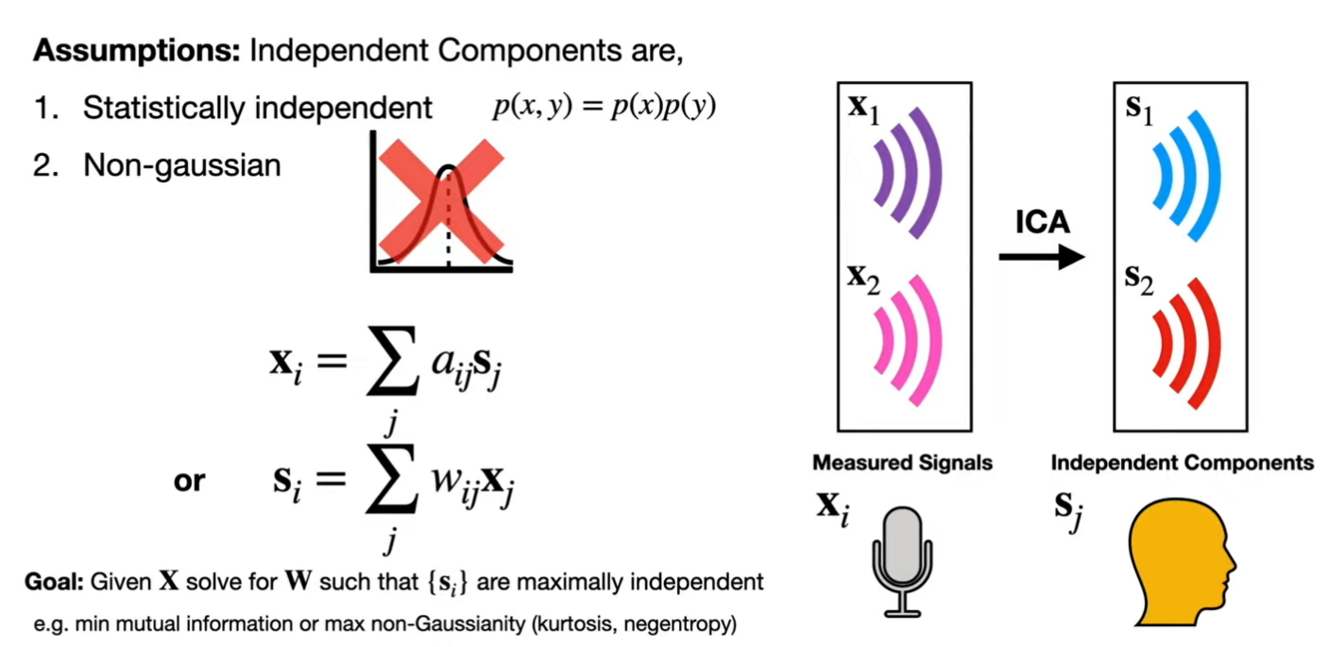

Slide 7
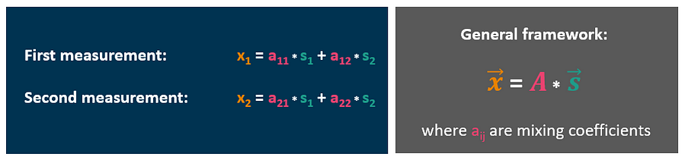


Slide 8
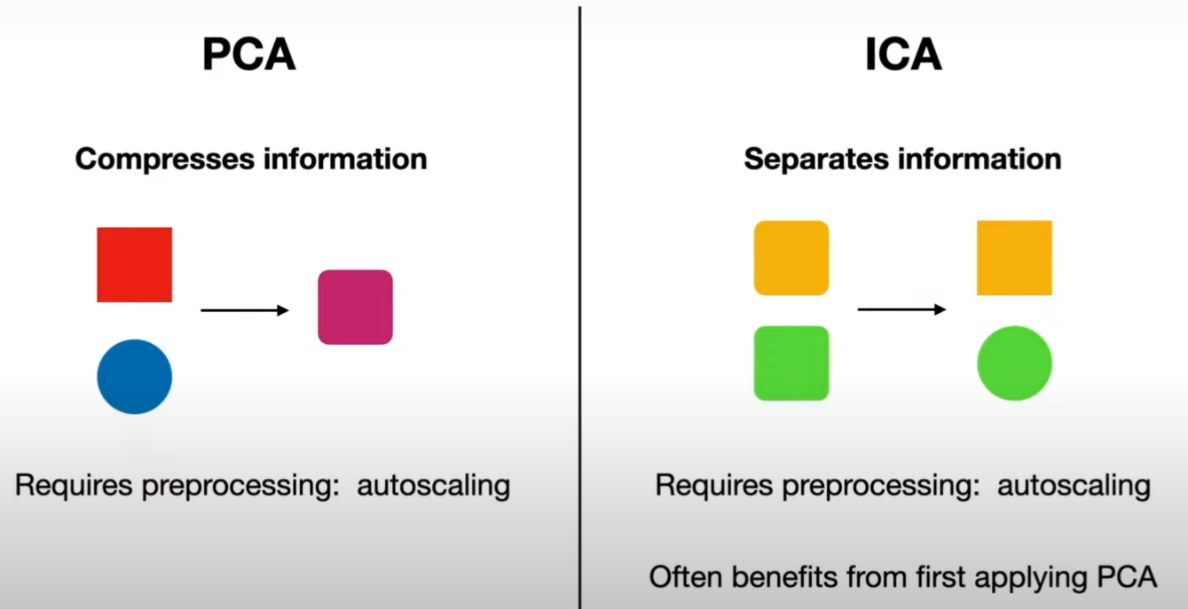
PCA & ICA

Slide 9
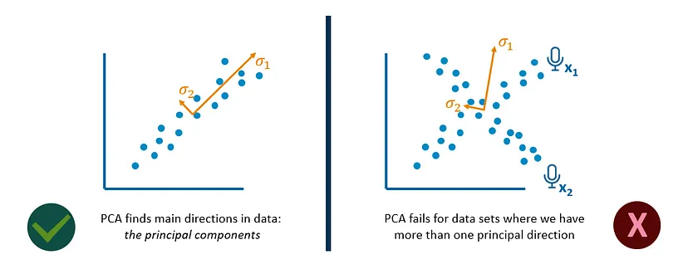
PCA & ICA

Slide 10
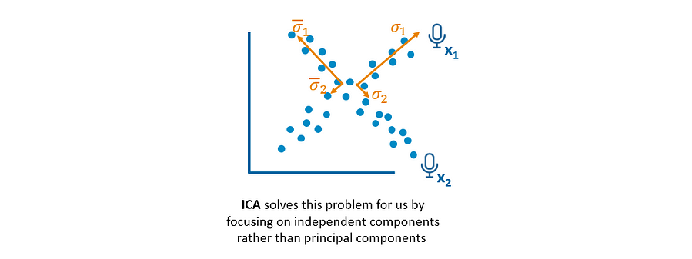

Slide 11
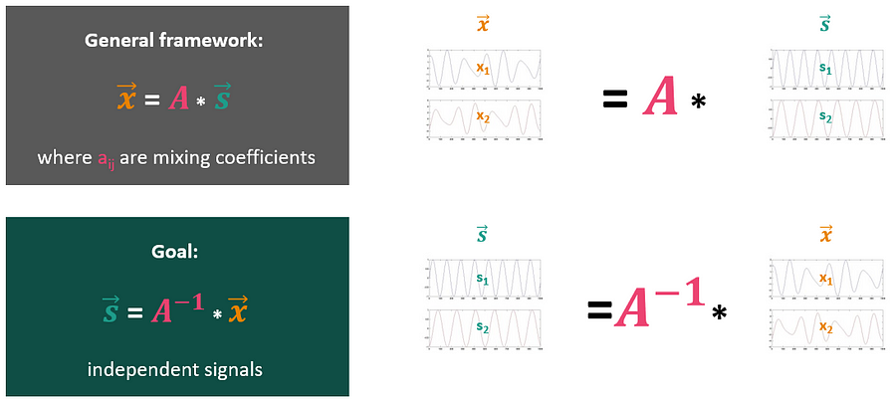

Slide 12
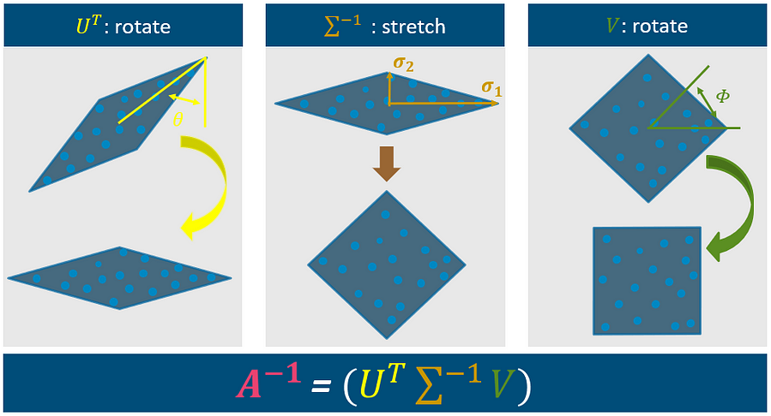
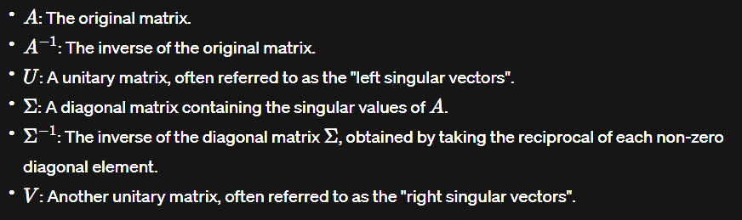

Slide 13
Applications
Image Processing: In image processing, ICA can be employed to separate an image into its underlying components, such as textures, patterns, or even the sources of noise, enabling applications like image enhancement, denoising, and object recognition.
Signal Separation: ICA is widely used in audio signal processing to separate mixed audio sources in scenarios like the “cocktail party problem.”
Medical Imaging: ICA is crucial in medical imaging, particularly functional Magnetic Resonance Imaging (fMRI). It helps separate and analyze brain activation patterns, aiding in studying cognitive processes and neurological disorders.
Financial Data Analysis: In finance, ICA is used to identify latent factors that influence stock price movements, helping traders and analysts uncover hidden market trends and anomalies.

